Slide 1
Test Automation & Fast
Building Quality into Software Faster

Slide 2


Why Test Automation?
Fast feedback on changes throughout software delivery lifecycle
Reduces manual regression testing time and cost
Increases reliability of testing
Enables frequent releases and quicker feedback for developers

Slide 3
Drawbacks of Manual Testing
Time-consuming and expensive
Unreliable for repetitive tasks
Long feedback cycles
Quality often seen as "somebody else's problem"
Difficulty maintaining up-to-date test documentation

Slide 4
How to implement automated testing
Create and curate automated test suites
Perform testing continuously throughout software delivery lifecycle
Integrate tests into continuous delivery pipelines
Improves software stability, reduces team burnout, lowers deployment pain

Slide 5
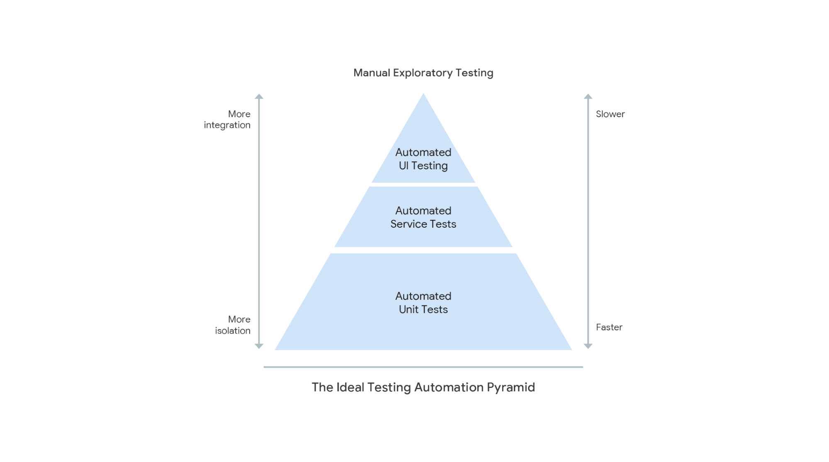
Key technical activity
Testers work alongside developers
Encourage developers to be responsible for creating and maintaining test suites
Unit Tests
Acceptance Tests

Slide 6
Measuring Automated Testing
Percentage of tests written by developers, testers, and any other group in your company.
Change in proportion of bugs found over time.
Track the quantity of automated test failures that represent a real defect and the quantity which were poorly coded.

Slide 7
Common Pitfalls
Not involving developers in testing
Test suites frequently in a broken state
Developers writing hard-to-test code
Need for continuous review and improvement of test suites

